Slide 1


Diving into the Digital Mirror: Unveiling the Magic of Data Twins
Presented by:
Tharun Polinati

Slide 2

Understanding Data
Twins
.
Digital Twins play a pivotal role in various industries, offering insights and opportunities that were previously unimaginable. By providing a digital representation of physical assets and processes, Digital Twins facilitate improved decision-making, enhanced productivity, and innovation across industries.

Slide 3

Key Features of Digital Twins
Real-time data monitoring and analysis
Simulation capabilities
Predictive analytics and forecasting
Remote operation and control

Slide 4
Key Technologies
Internet of Things (IoT) Devices
Sensors
Data Analytics and Machine Learning
Cloud Computing
Augmented Reality (AR) and Virtual Reality (VR)
Simulation Software
Block chain

Slide 5
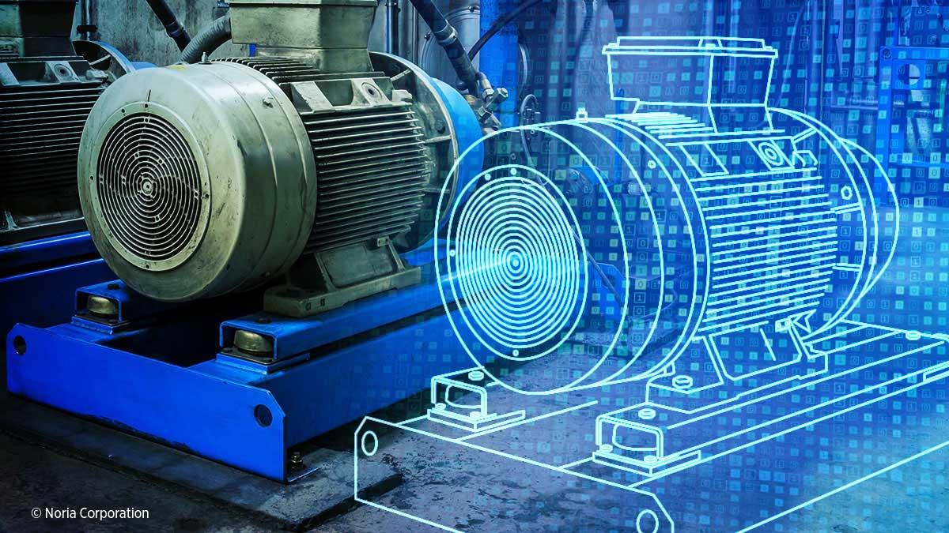

Slide 6
Impacts on society
Improved efficiency and productivity across industries.
Enhanced safety through predictive maintenance and monitoring.
Personalized healthcare for better patient outcomes.
Environmental sustainability via resource optimization.
Smart city planning for efficient urban development.
Remote operations in hazardous or remote environments.
Immersive education and training experiences.
Job creation and skills development opportunities.
Ethical considerations regarding data privacy and bias.
Potential for widening the digital divide if access is not equitable

Slide 7
Applications :
Manufacturing: Optimizing production processes, predictive maintenance, and quality control.
Healthcare: Personalized treatment plans, medical device simulation, and patient monitoring.
Aerospace and Defense: Simulation of aircraft components, predictive maintenance, and training simulations.
Automotive: Design validation, virtual testing, and predictive maintenance for vehicles.
Energy and Utilities: Monitoring and optimizing energy production and distribution systems.
Smart Cities: Urban planning, infrastructure management, and traffic optimization.
Building and Construction: Design validation, energy efficiency analysis, and smart building management.

Slide 8
Cons :
Complexity and Cost
Data Privacy and Security
Interoperability Issues
Accuracy and Reliability
Dependency on Connectivity
Ethical and Social Implications
Resistance to Change
Complexity of Integration

Slide 9
Thanks!

